Slide 1
Forensic biology and serology
presentation
LIST OF PROTECTED SPECIES IN INDIA
GROUP MEMBERS
ARAFA SIDHIQUE
AJISHA
ALAN TITUS
AJAY JOY P
AYUSH RAJ R

Slide 2
INTRODUCTION
PROTECTED SPECIES
An endangered species is a species that is very likely to become extinct in the near future.Certain species are protected by gv law, meaning that it can be illegal to kill, injure or capture birds or animals or to pick or damage certain wild plants.More than 1,600 animals and plants are protected, or “listed,” as endangered.Species and their populations are the building blocks of ecosystems, individually and collectively securing the conditions for life. They provide food, medicine and raw materials. They are the basis of soil formation, decomposition, water filtration and flow, pollination, pest control and climate regulation.Habitat loss is the primary cause of higher extinction rates. Other causes include habitat changes, over-exploitation of wildlife for commercial purposes, the introduction of harmful nonnative species, pollution, and the spread of diseases.National Parks, Sanctuaries, Conservation Reserves and Community Reserves covering important wildlife habitats have been created all over the country under the provisions of the Wild Life (Protection) Act, 1972 to conserve wild animals and their habitats.

Slide 3
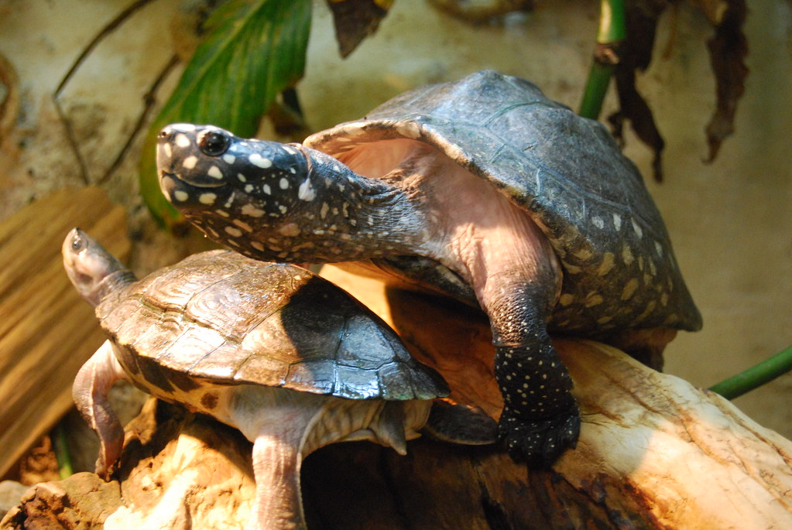
Assam Roofed Turtle
The Assam roofed turtle or Sylhet roofed turtle (Pangshura sylhetensis) is a turtle species of the family Geoemydidae found in the Brahmaputra-Meghna drainage in India (Assam) and parts of eastern Bangladesh.

Slide 4
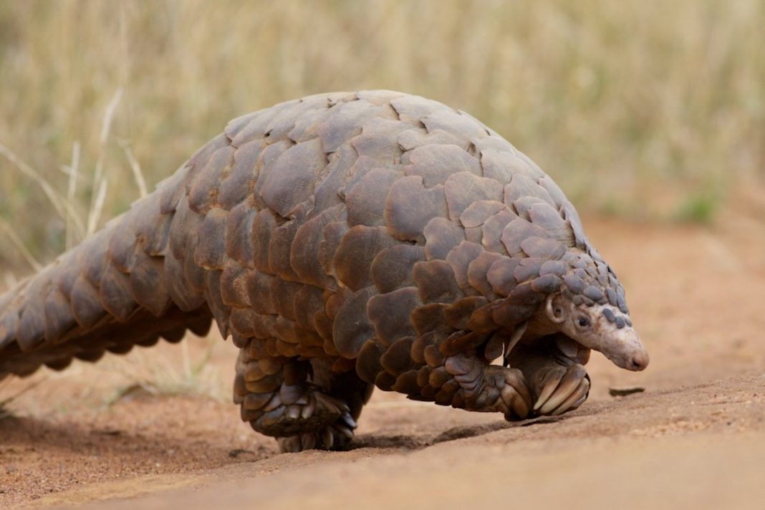
Pangolins
The physical appearance of a pangolin is marked by large, hardened, overlapping, plate-like scales.They are made of keratin.

Slide 5
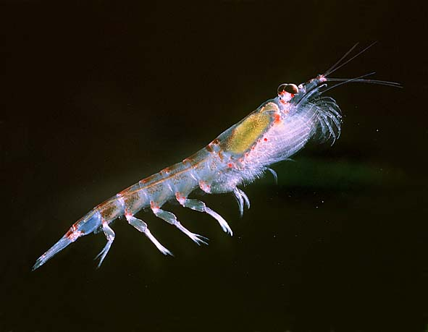
Antartic krill
Antarctic krill (Euphausia superba) is a species of krill found in the Antarctic waters of the Southern Ocean. It is a small, swimming crustacean that lives in large schools, called swarms,

Slide 6
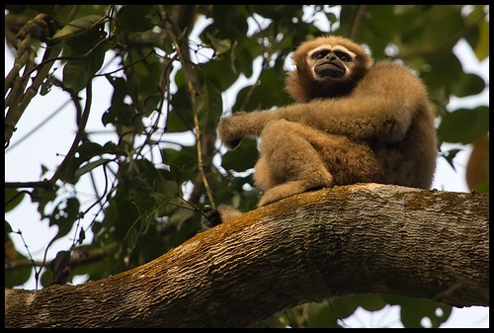
Hoolock Gibbon
The hoolock gibbons are three primate species of genus Hoolock in the gibbon family, Hylobatidae, native to eastern Bangladesh, Northeast India, Myanmar, and Southwest China.

Slide 7
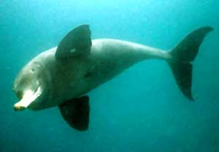
Gangetic Dolphins
The Ganges river dolphin (Platanista gangetica) is a species of toothed whale classified in the family Platanistidae. It lives in the Ganges and related rivers of South Asia, namely in the countries of India, Nepal, and Bangladesh

Slide 8
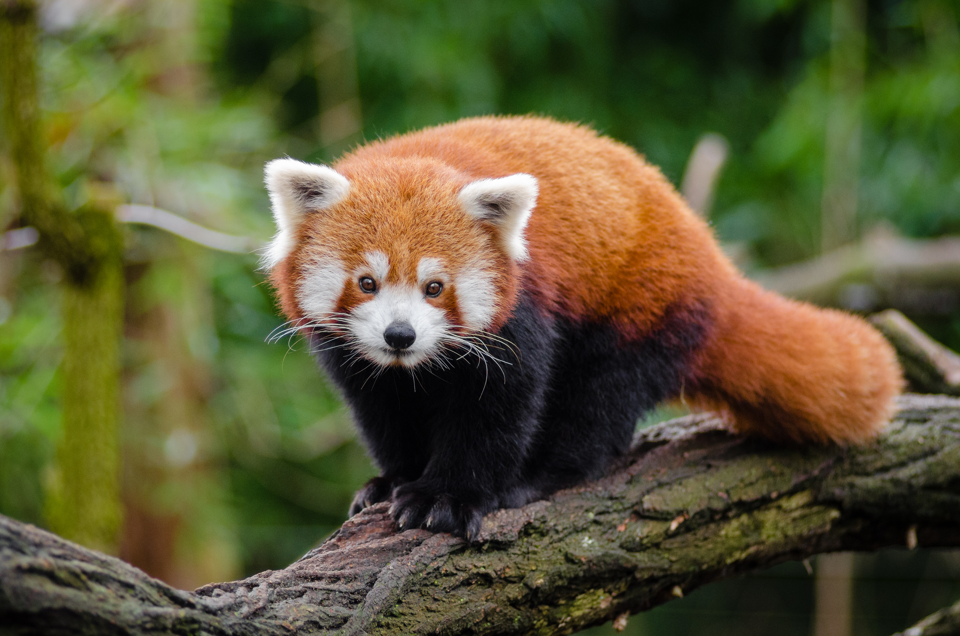
Red panda
Red Panda is a small mammal native to the eastern Himalayas and southwestern China. It has dense reddish-brown fur with a black belly and legs, white-lined ears, a mostly white muzzle and a ringed tail

Slide 9
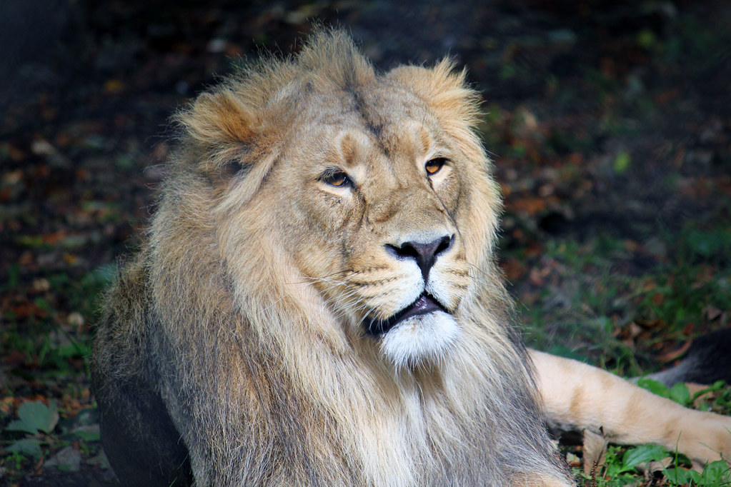
Asiatic lion
Asiatic lions are slightly smaller than African lions.Since the turn of the 20th century, its range has been restricted to Gir National Park and the surrounding areas in the Indian state of Gujarat

Slide 10
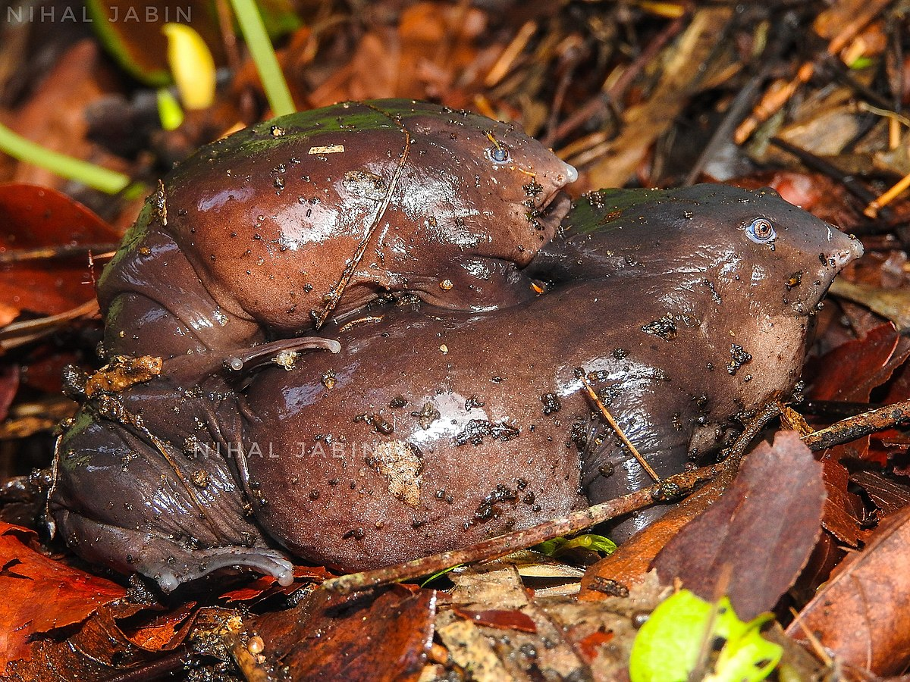
The purple frog
The purple frog is also known as pignose frog, was first discovered in October 2003 in the Idukki district of KeralaIt is endemic to the Western Ghats in India and was not noticed until recently as it remains underground most of the year except for 2-3 weeks during the monsoon when it comes out to mate.

Slide 11
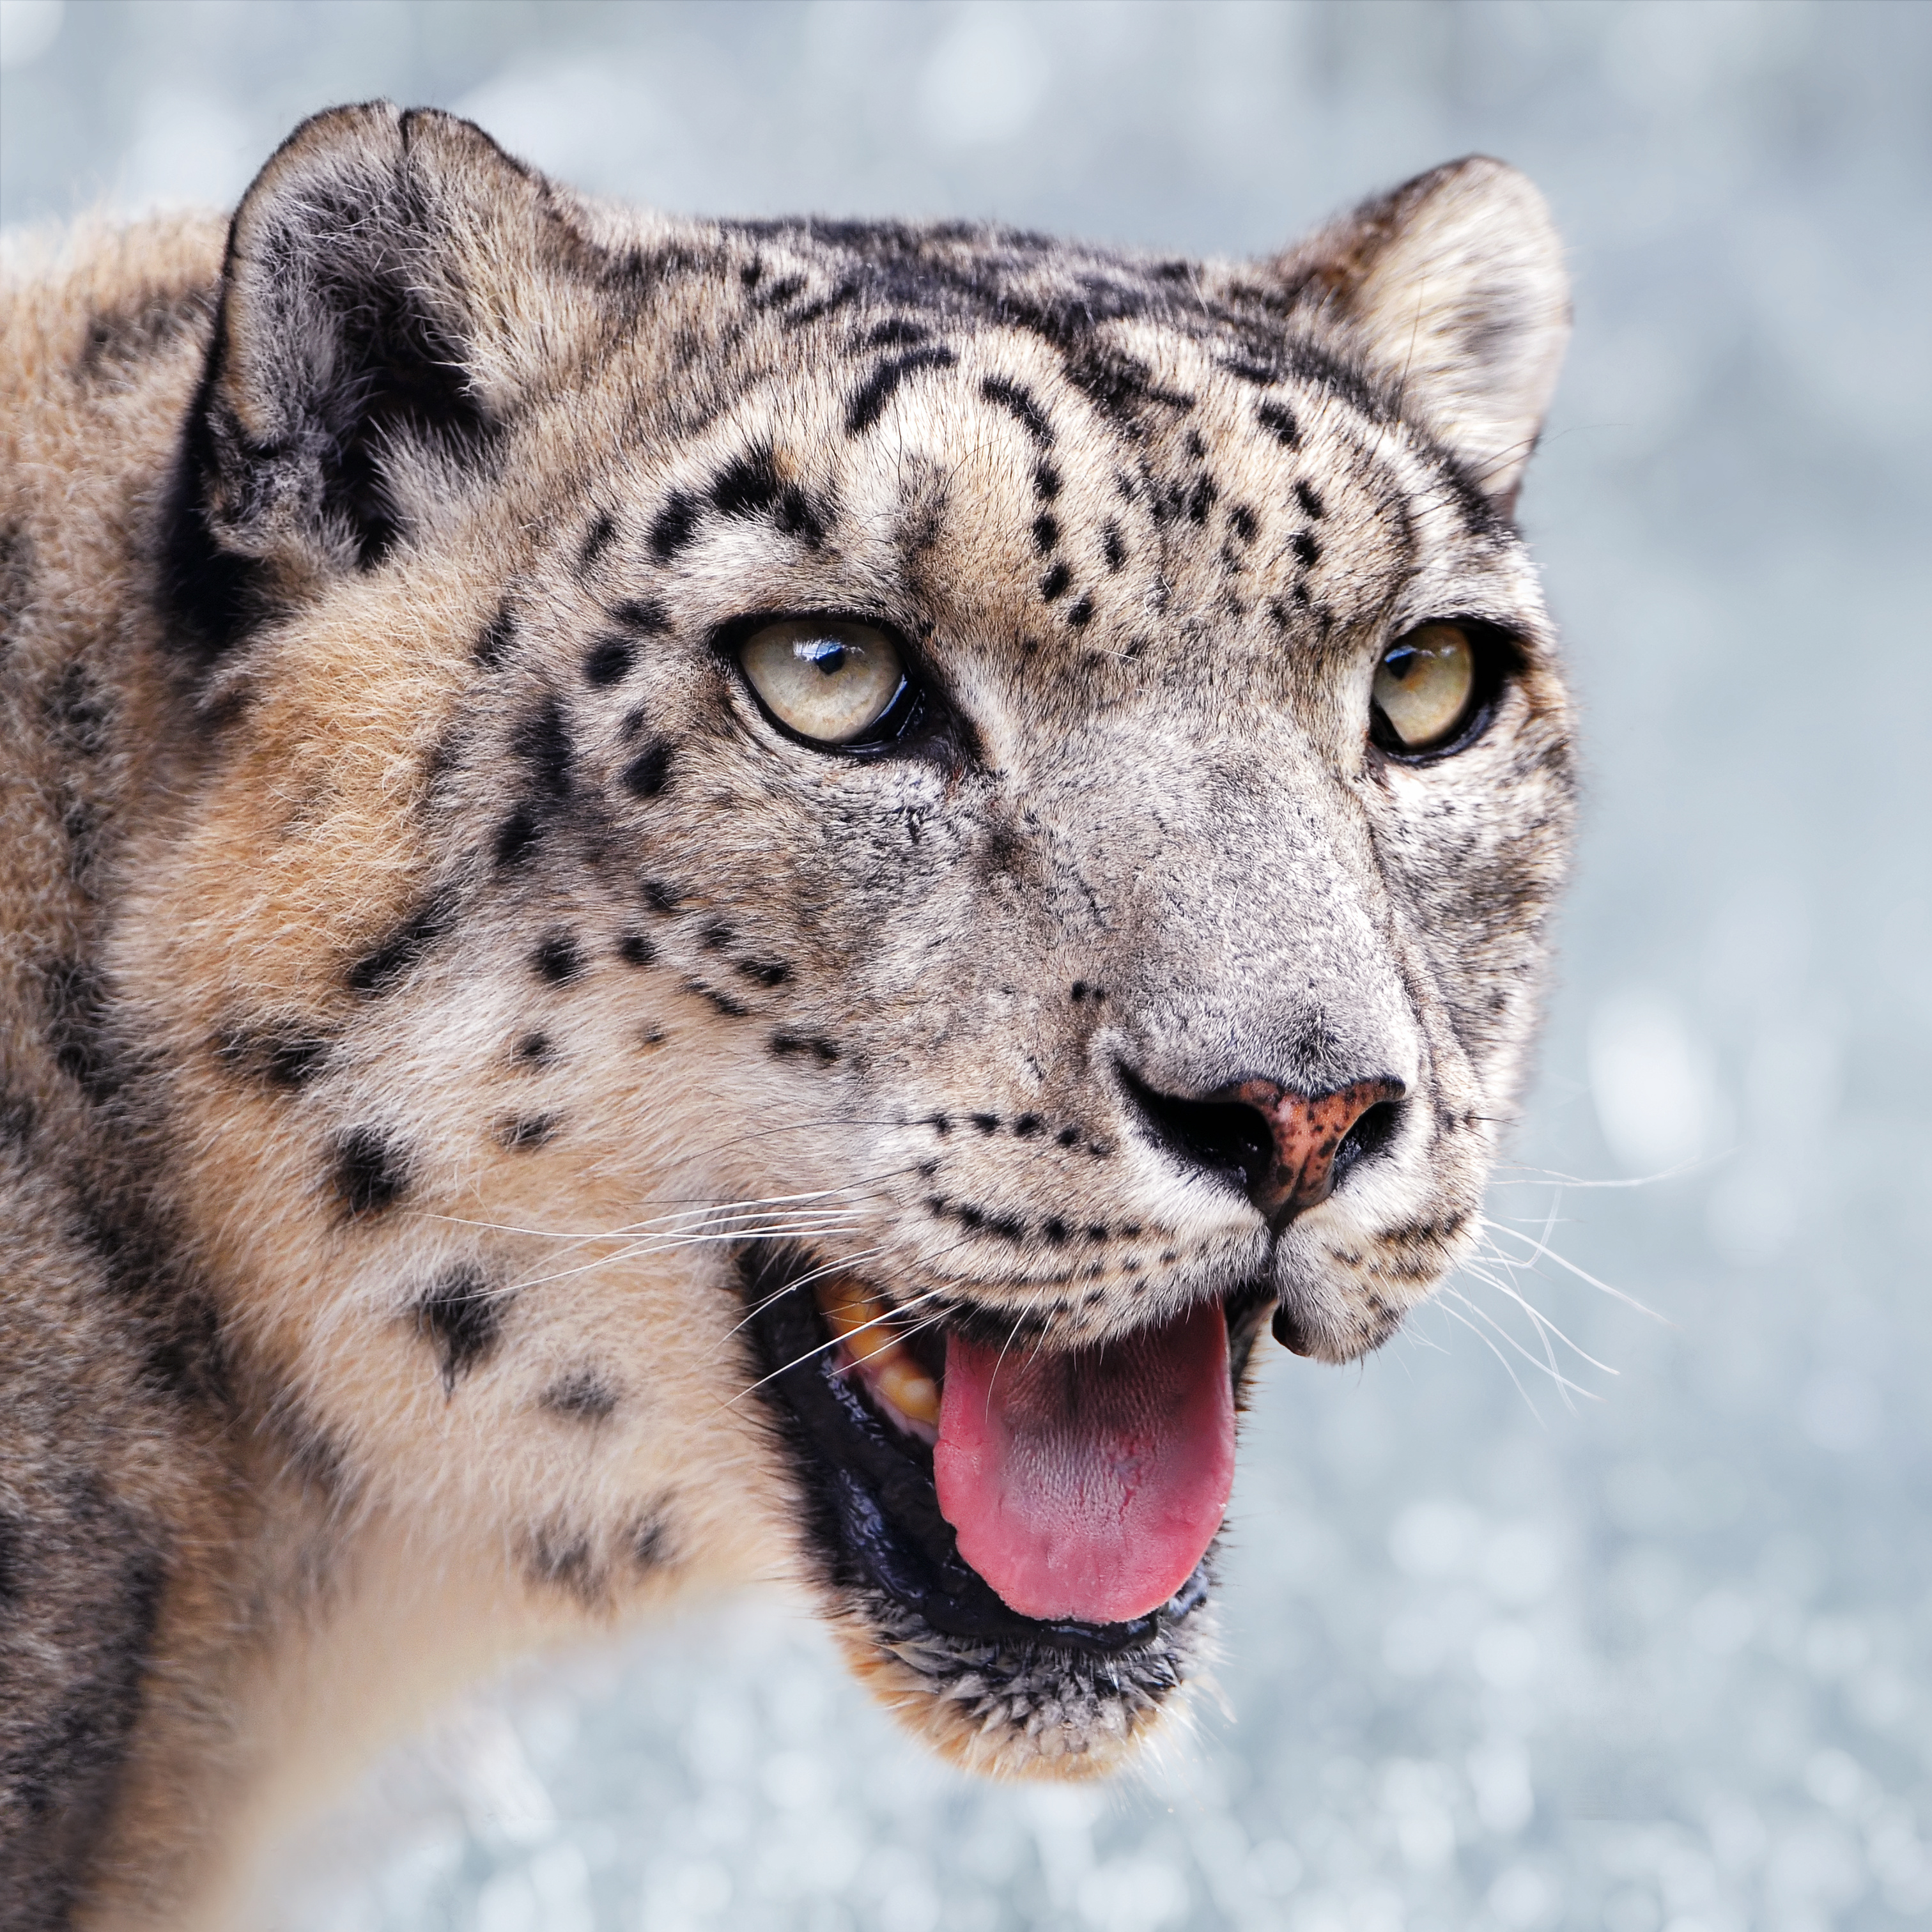
Snow Leopard
The snow leopard (Panthera uncia), commonly known as the ounce, is a species of large cat in the genus Panthera of the family Felidae.
This Photo by Unknown Author is licensed under CC BY-SA

Slide 12
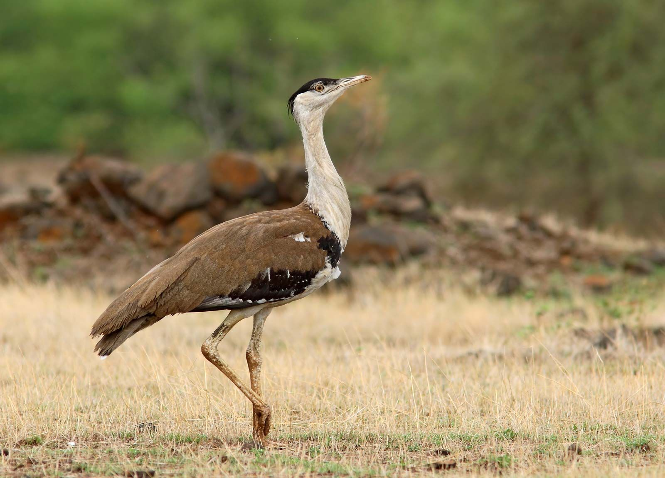
Great Indian Bustard
The great Indian bustard (Ardeotis nigriceps) or Indian bustard, is a bustard found on the Indian subcontinent, or in Rajasthan, in the Thar Desert. A large bird with a horizontal body and long bare legs, giving it an ostrich like appearance, this bird is among the heaviest of the flying birds.

Slide 13
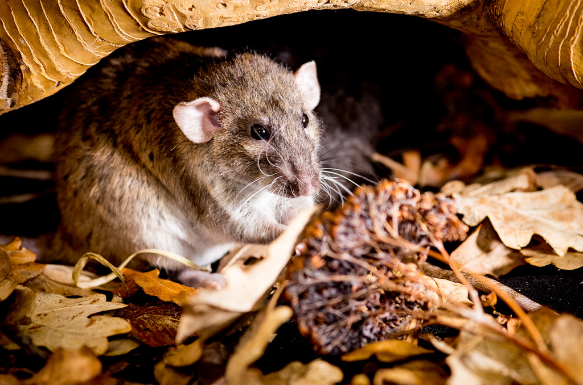
Vermins
Vermin (colloquially varmint or varmit) are pests or nuisance animals that spread diseases or destroy crops, livestock, and property.

Slide 14
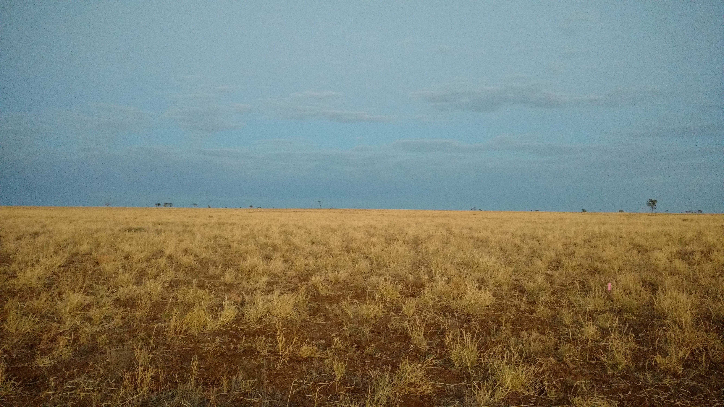
Banni Grasslands
They are known for rich wildlife and biodiversity and are spread across an area of 3,847 square kilometres. They are currently legally protected under the status as a protected or reserve forest in India.

Slide 15

Marine National Park
Marine National Park in the Gulf of Kutch is situated on the southern shore of the Gulf of Kutch in the Devbhumi Dwarka district of Gujarat state, India.

Slide 16
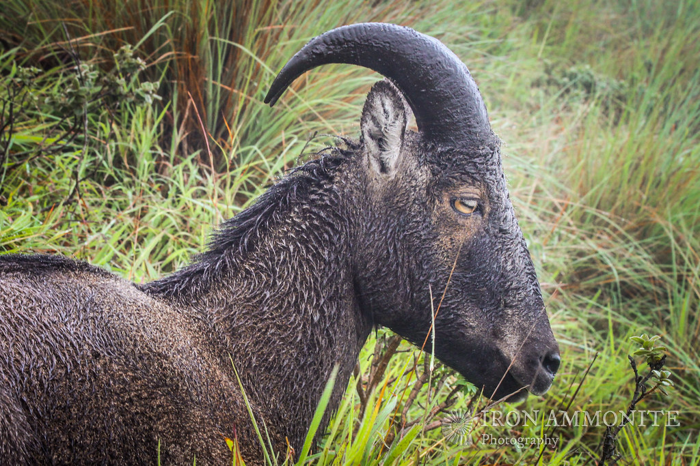
Nilgiri tahr
The Nilgiri tahr is an ungulate that is endemic to the Nilgiri Hills and the southern portion of the Western and Eastern Ghats in the states of Tamil Nadu and Kerala in southern India. It is the only species in the genus Nilgiritragus and is closely related to the sheep of the genus Ovis.

Slide 17
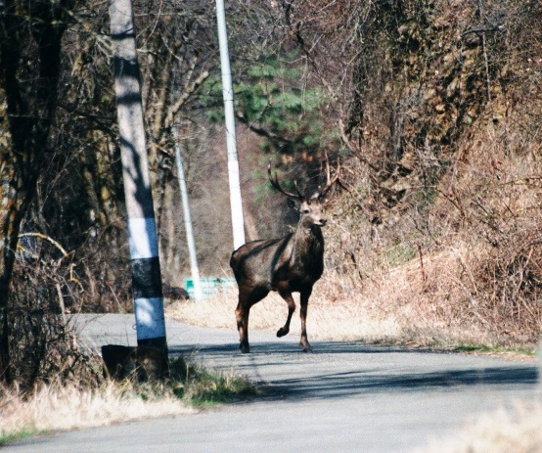
KASHMIR STAG
It is a subspecies of Central Asian red deer endemic to Kashmir and surrounding areas. It is found in dense riverine forests in the high valleys and mountains of Jammu and Kashmir and northern Himachal Pradesh.

Slide 18
CONCLUSION
Several species of animals and plants have been listed as protected species by International union for conservation of nature (IUCN).The existence of some animals that are vital for the development of the ecosystem of the wildlife is facing critical issues of extinction.This is because of deforestation,habitat lose, pollution,over hunting and other natural causes.When a species becomes endangered, it is a sign that the ecosystem is slowly falling apart. Each species that is lost triggers the loss of other species within its ecosystem. Humans depend on healthy ecosystems to purify our environment.so it is our responsibility to protect these species inorder to have a safe future.

Slide 19
REFERENCE

